Slide 1

UNDERSTANDING RISK
Pankaj Vajpayee

Slide 2
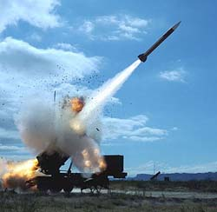

OCTOBER 6, 1973

Slide 3
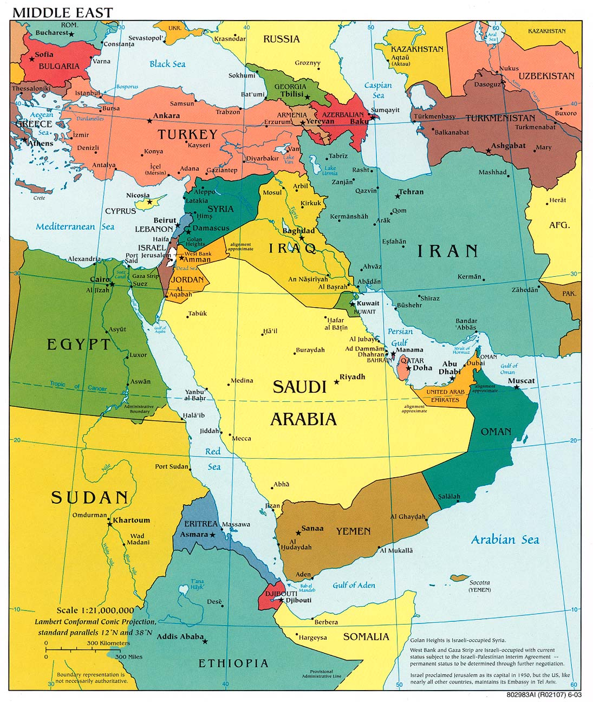
YOM KIPPUR WAR
EGYPTIAN AND SYRIAN ARMED FORCES INVADED ISRAEL

Slide 4
YOM KIPPUR WAR
Ten days later OPEC used “OIL WEAPON” for the first time
OIL went from $2/b in September to $11.65/b by December.
The first “OIL CRISIS” was upon us

Slide 5


OPEC OIL EMBARGO HAD LITTLE TO DO WITH PRICE RISE

Slide 6

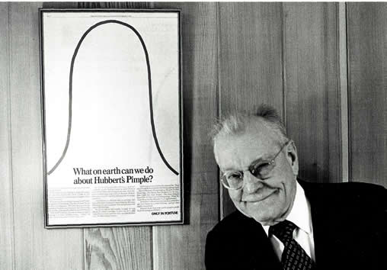
MAKING OF A CRISIS
In 1956 King Hubbert former professor at Columbia University and scientist at Shell Company had predicted that US will peak as oil producer by the early 1970’s
By 1970 US was pumping 9.6m barrels of oil/day. Saudi was producing less than half
By 1973 oil supplies peaked and by 1981 US was pumping 1/3 rd less in 48 states

Slide 7
OIL CRISIS 2004
Oil crossed $40/barrel for the first time in decades
It was under $10/barrel six years earlier
Sept. 2004- Oil touched $50/b
US & Asian economies were growing faster than anytime in the last 15 years

Slide 8

OIL CRISIS
INTERNATIONAL ENERGY AGENCY OCTOBER 2004 UPDATE
SUPPLIES : 83.2m barrels/day and declining
DEMAND : 82.5m barrels/day and rising
IEA forecast in 2007 says Oil supply looks tight than ever before in the next 5 years

Slide 9
OIL CRISIS 2008
Oil touched $147/barrel for the first time
Oil retraced back to under $60/ barrel ( almost 60% drop)
US & Asian economies are facing a possible recession.
Prices remain very volatile, with unprecedented daily swings. Investment in oil refining capacity to be hit and oil likely to cross $100 / barrel.

Slide 10
NEED TO MANAGE COMMODITY RISK
Significant, sometimes abrupt changes in supply and demand and pricing have touched many of the commodity markets during the past three decades, especially those for energy
International Politics, war, changing economic patterns and structural changes within energy markets have created considerable uncertainty as to the future direction of market conditions
Uncertainty leads to market volatility and the need for an effective means to hedge the risk of adverse price exposure

Slide 11

EMERGENCE AND GROWTH OF DERIVATIVE MARKETS
Exponential Growth of the Derivatives Market post 1970
Key Economic and Technological Factors
  Breakdown of the Bretton Woods System
  Oil price shocks of 1973
  Excess government spending and high inflation in USA in 1970’s
  Exponential Increase in World Trade, Capital Flows and dismantling of Tariff barriers
  Technological innovations like advancement in communication and information technologies enabled effective implementation of derivatives

Slide 12

What is Risk?
Risk, in traditional terms, is viewed as a ‘negative’. Webster’s dictionary, for instance, defines risk as “exposing to danger or hazard”.
The Chinese give a much better description of risk
The first is the symbol for “danger”, while
The second is the symbol for “opportunity”, making risk a mix of
danger and opportunity.

Slide 13
Risk Management
Risk management is present in all aspects of life; It is about the everyday trade-off between an expected reward an a potential danger. In the business world, we often associate risk with some variability in financial outcomes. However, the notion of risk is much larger. It is universal, in the sense that it refers to human behaviour in the decision making process. Risk management is an attempt to identify, to measure, to monitor and to manage uncertainty.

Slide 14
Types of financial risk
Equity Risk
Trading Risk
Market Risk
Interest Rate Risk
Gap Risk
Currency Risk
Commodity Risk
Transaction
Risk
Counterparty
Risk
Credit Risk
Financial
Risks
Portfolio
Concentration
Risk
Liquidity Risk
Issuer Risk
Operational Risk
Regulatory Risk
Human Factor
Risk

Slide 15
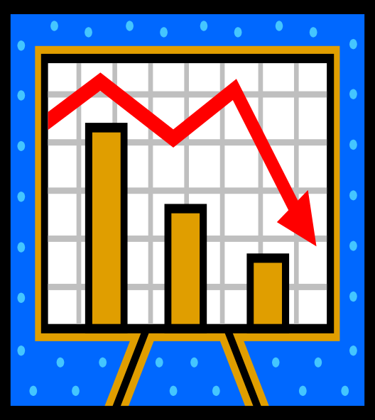
Understanding Market Risk
It is the risk that the value of on and off-balance sheet positions of a financial institution will be adversely affected by movements in market rates or prices such as interest rates, foreign exchange rates, equity prices, credit spreads and/or commodity prices resulting in a loss to earnings and capital.

Slide 16
Why the focus on Market Risk Management ?
Convergence of Economies
Easy and faster flow of information
Skill Enhancement
Increasing Market activity
Leading to
Increased Volatility
Need for measuring and
managing market Risks
Regulatory focus
Profiting from Risk

Slide 17
THANK YOU

